Slide 1
Security Controls in Shared Source Code Repositories
Daniel Fryer
Assignment 10.2
10/3/2026

Slide 2
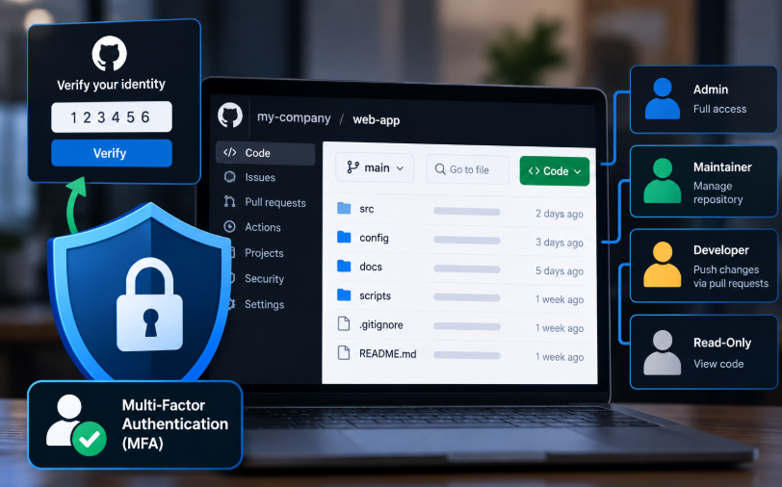
Secure Identities
Only employees who need to work on the source code should be given access to the repository.
Use robust authentication.
Review and update permissions for users on a regular basis.

Slide 3
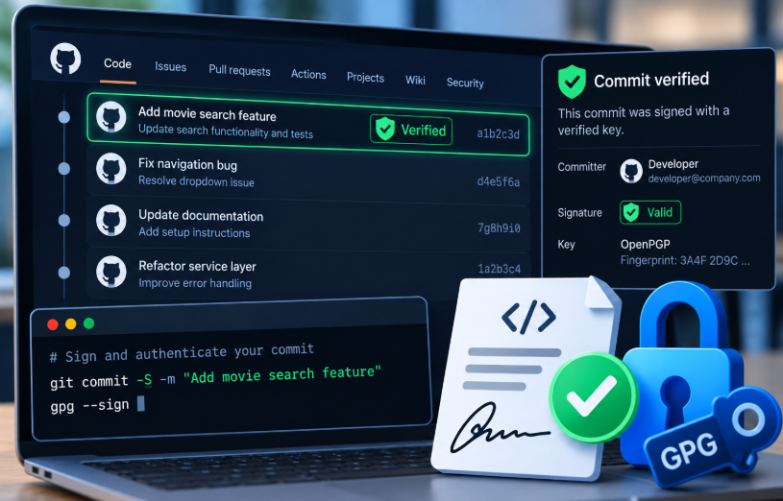
Sign and Authenticate Code Commits
Enforcing of code comments ensure code integrity and authenticity.
Verifying who is uploading the code can prevent unauthorized code modifications

Slide 4
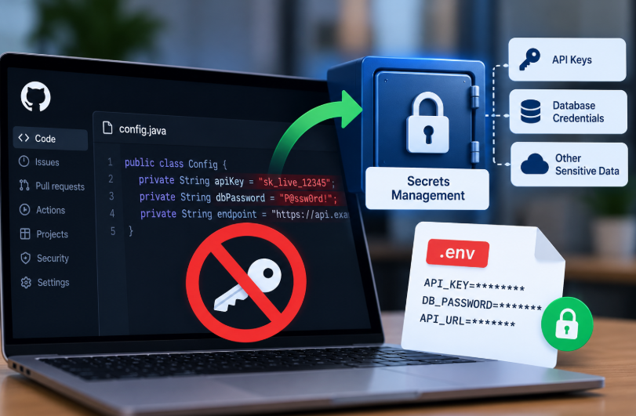
Keep Secrets… Secret
Keep API keys and passwords out of the source code.
Use a secure management system to handle the sensitive data.

Slide 5
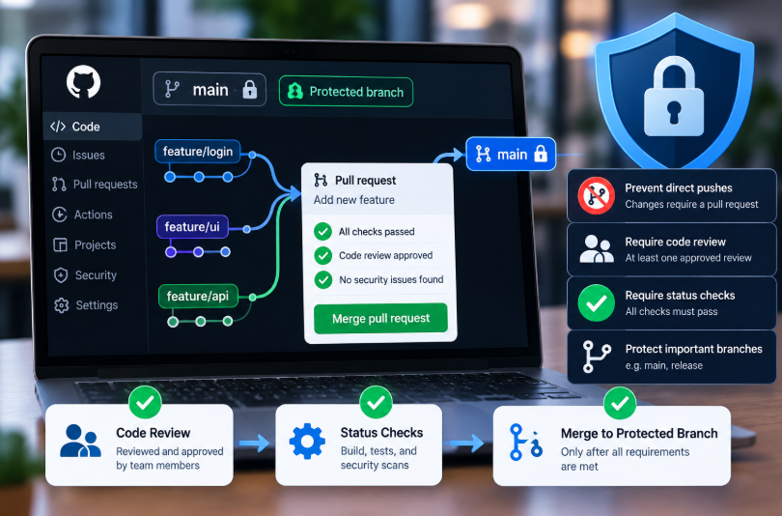
Source Code Protection/Branch Protection
Have a well defined and enforceable source control policy.
Using a process that all code is reviewed and passes status checks helps protect the branches.
Continuous training of developers about security best practices.

Slide 6
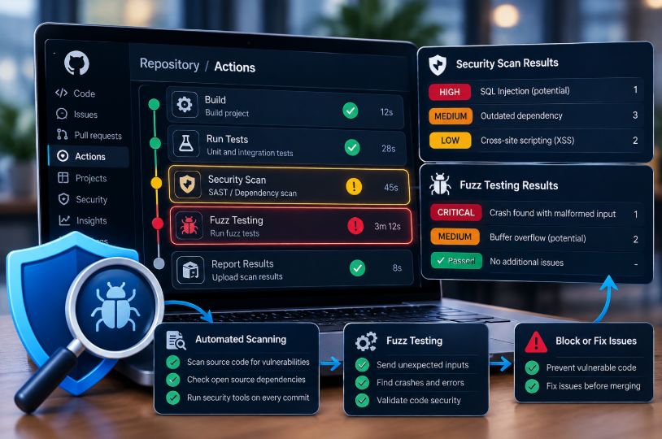
Monitor Source Code/Fuzz Test
Use automated vulnerability scanning tools to monitor the source code.
Require fuzz testing of the code to make sure that it holds up to security standards before being pushed to the repository.

Slide 7
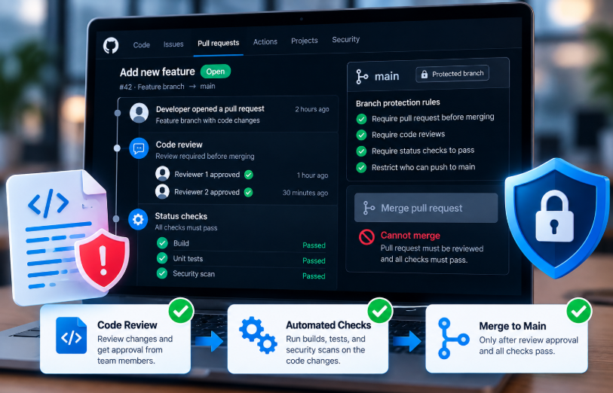
Prevent Vulnerable Code in Production
Define and maintain a code review process.
Fix issues before merging into the main branch.
Make sure that no one developer can push merge code without it being reviewed.

Slide 8
Resources:
https://checkmarx.com/blog/supply-chain-security/repository-health-monitoring-part-2-essential-practices-for-secure-repositories/
https://snyk.io/articles/securing-source-code-repositories/

